Slide 1

Factory Pattern
Daniil dubaleka it3o

Slide 2

Agenda
What is Factory Pattern?
Where is it used?
Advantages and Disadvantages?
Example and Practical task

Slide 3


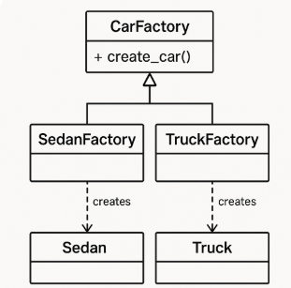
What is Factory Method
Factory Method is a creational design pattern that provides an interface for creating objects in a superclass, but allows subclasses to alter the type of objects that will be created.

Slide 4
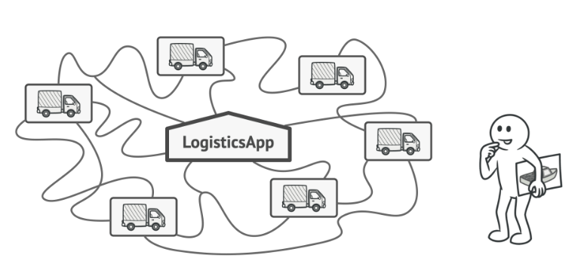
Problem
Imagine that you’re creating a logistics management application. The first version of your app can only handle transportation by trucks, so the bulk of your code lives inside the TRUCK class. After a while, your app becomes pretty popular. Each day you receive dozens of requests from sea transportation companies to incorporate sea logistics into the app.

Slide 5
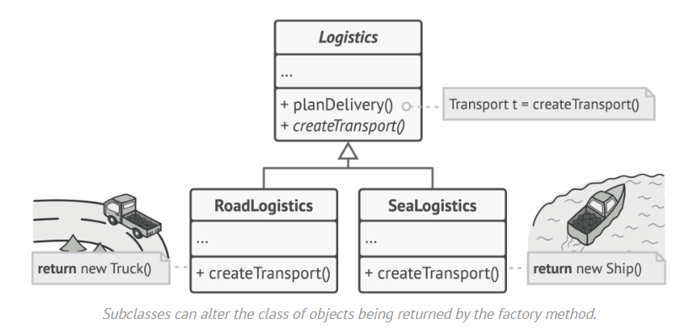
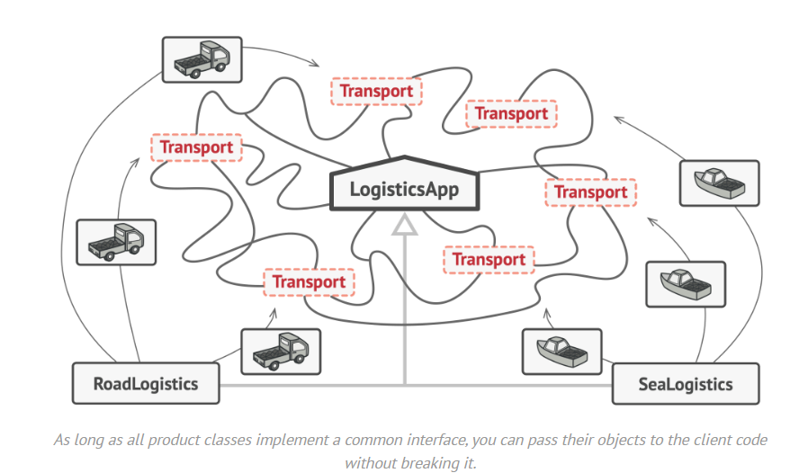
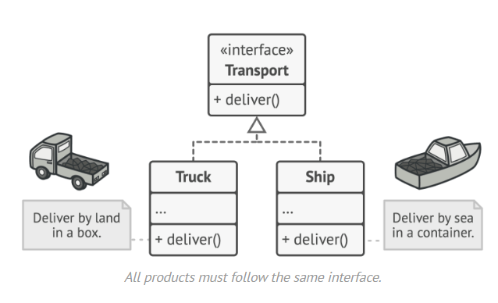
Solution
The Factory Method pattern suggests that you replace direct object construction calls (using the NEW. operator) with calls to a special factory method. Don’t worry: the objects are still created via the new perator, but it’s being called from within the factory method. Objects returned by a factory method are often referred to as products.

Slide 6
Applicability
Use the Factory Method when you don’t know beforehand the exact types and dependencies of the objects your code should work with.
Use the Factory Method when you want to provide users of your library or framework with a way to extend its internal components.
Use the Factory Method when you want to save system resources by reusing existing objects instead of rebuilding them each time.

Slide 7
Advantages and Disadvantages
Advantages
Disadvantages
You avoid tight coupling between the creator and the concrete products.
Single Responsibility Principle. You can move the product creation code into one place in the program, making the code easier to support.
Open/Closed Principle. You can introduce new types of products into the program without breaking existing client code.
The code may become more complicated since you need to introduce a lot of new subclasses to implement the pattern. The best case scenario is when you’re introducing the pattern into an existing hierarchy of creator classes.

Slide 8

example of implementation of Factory Pattern in c#

Slide 9

Vielen Dank

